Slide 1








Slide 2
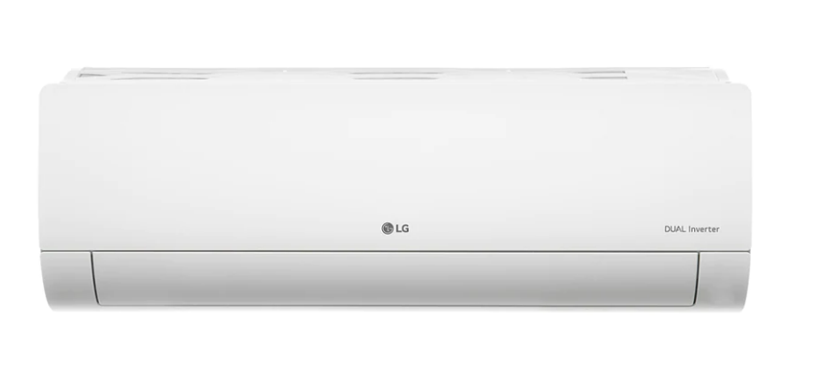

WEB SCRAPPING AND EXPLORATORY DATA ANALYSIS ON

Slide 3
About :
NAME: V.VINAY KUMAR
QUALIFICATION: BTECH(C.S.E)

Slide 4
Air-conditioning is process used to create and maintain certain temperature, relative humidity and air purity conditions in indoor spaces.
An air conditioner provides cold air inside an enclosed space by removing heat and humidity from the indoor air. It returns the cooled air to the indoor space, and transfers the unwanted heat and humidity outside.
The refrigerant absorbs heat from the environment and converts it into a cool air flow when combined with the other components such as compressors and evaporators.
Main mechanical components: Compressor, Fan , Condenser coil and Evaporator coil.
A Ton of refrigeration is the rate of heat transfer that results in the melting of 1 Ton of pure ice at 0 C (32 F) in 24 hours. The value is equal to 12,000 BTU per hour, or 3517 watts.
BTU (British thermal unit) is the amount of heat required to raise the temperature of 1 pound of liquid water by 1 degree Fahrenheit at a constant pressure of 1 atmosphere).
1 Ton AC = 12000 BTU/hr = 3517 Watts* (approx.)
1.5 Ton AC = 18000 BTU/hr= 5275.5 Watts
2 Ton AC = 24000 BTU/hr= 7034 Watts
Power Consumption (kWh)- It is the annual power consumption when AC is used for 1600 hours usage for 25C indoor temperature when outdoor temperature is between 35-40C

Slide 5
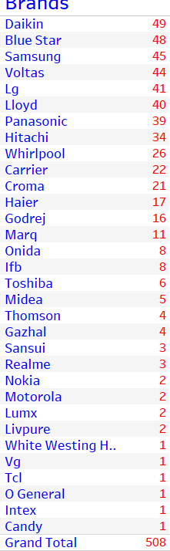
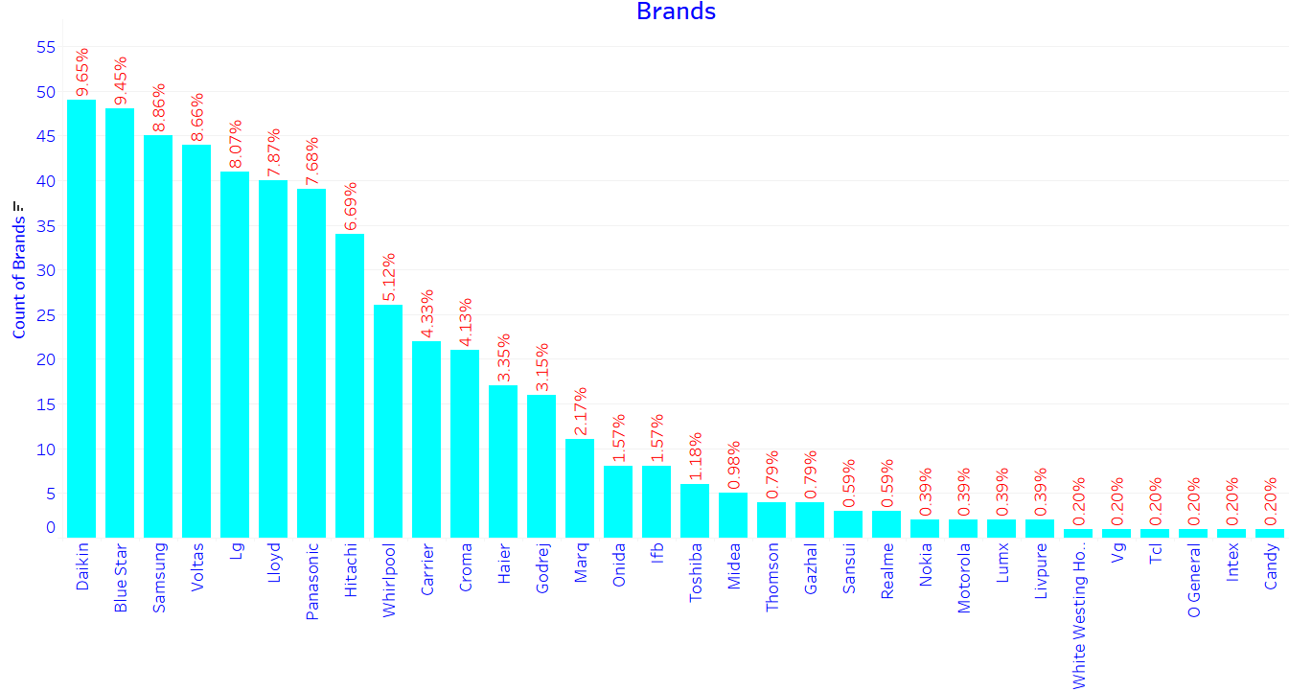

Slide 6
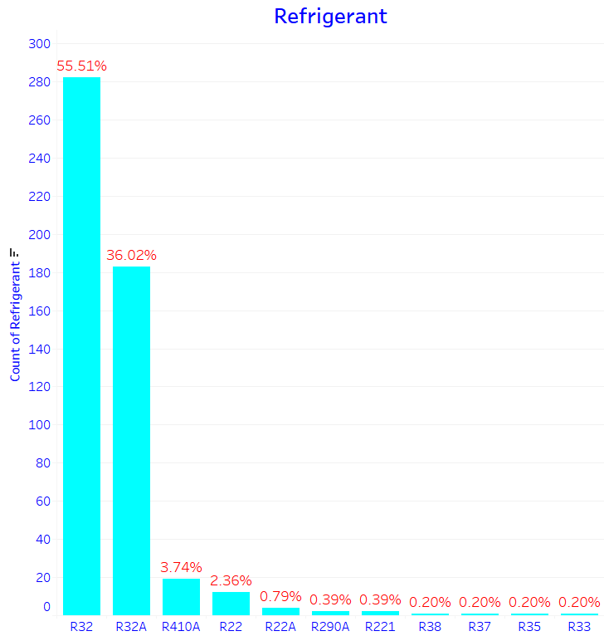
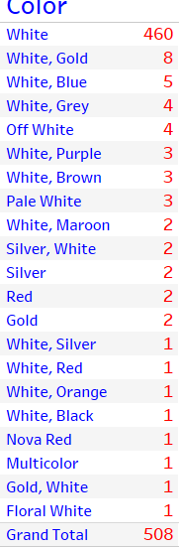
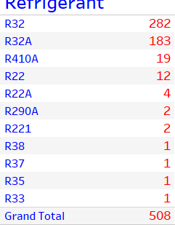
R32 is widely using Refrigerant followed by R32A
Most of the ACs are white colored and mixed color variants with white

Slide 7
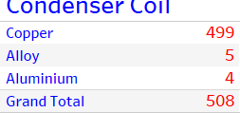
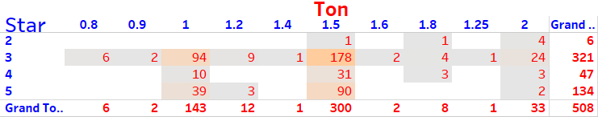
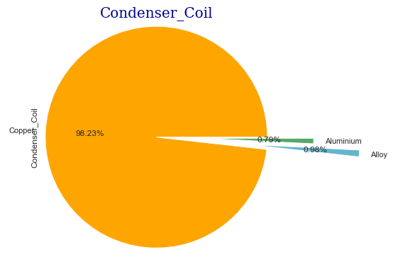
Availability- (1.5 Ton 3 Star)< (1 Ton 3 Star)< (1.5 Ton 5 Star)
Copper Condenser ACs are widely available.

Slide 8
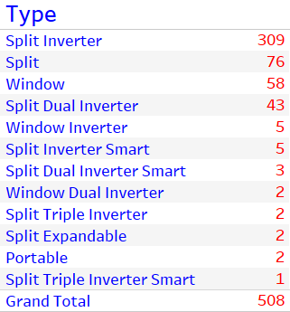
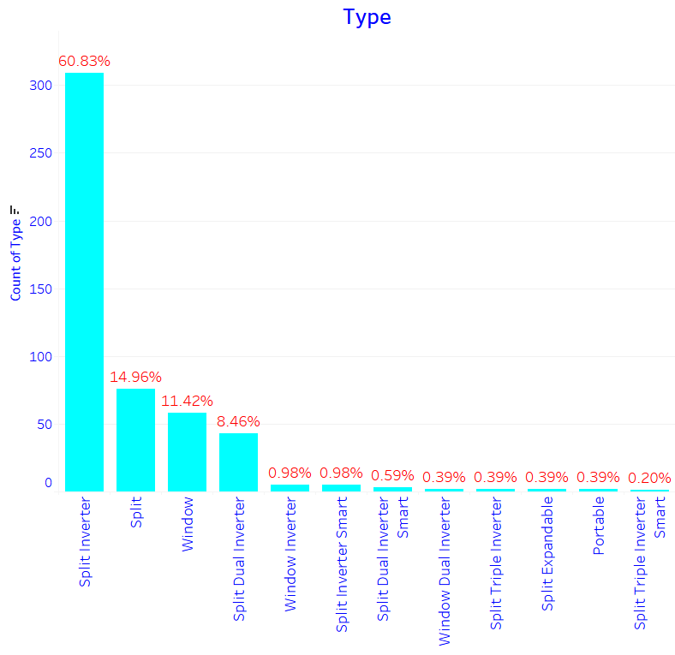
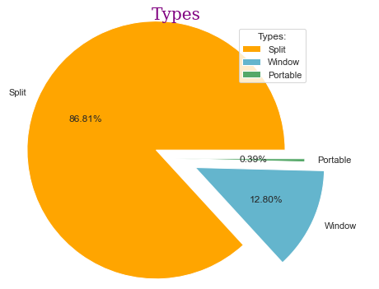

Slide 9
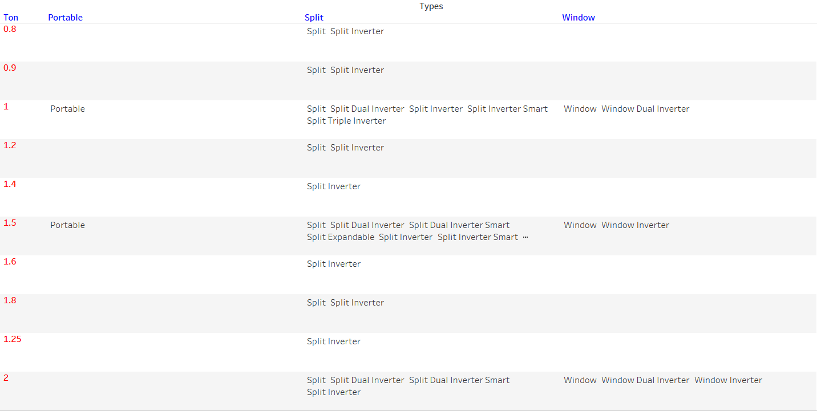
Split ACs are available with all cooling capacities
Portable ACs are available with 1 & 1.5 Ton cooling capacities
Window ACs are available with 1,1.5 & 2 Ton cooling capacities

Slide 10
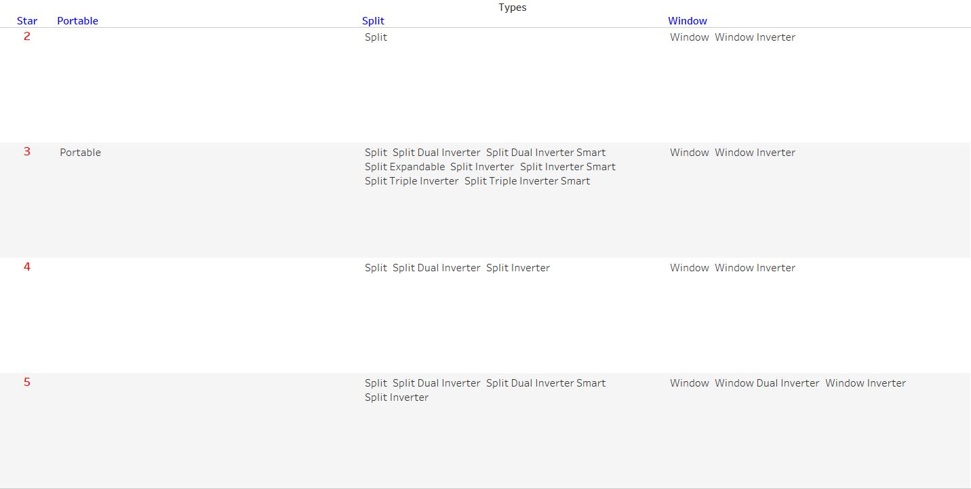
Split & Window ACs are available with all energy ratings where as Portable ACs are available with 3 Star

Slide 11
OFFER PRICE ANALYSIS

Slide 12
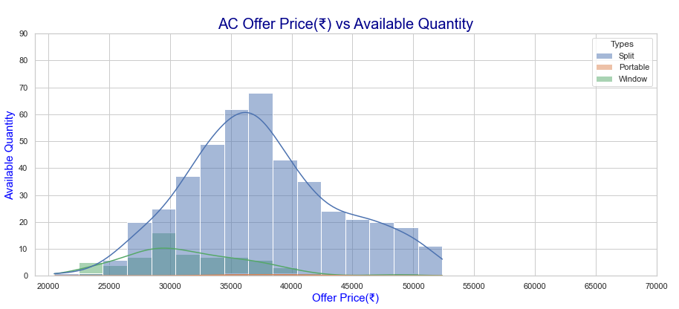
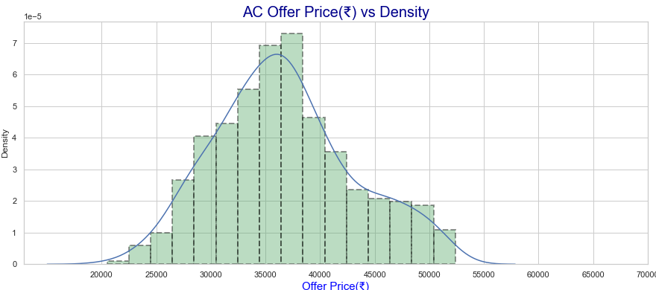
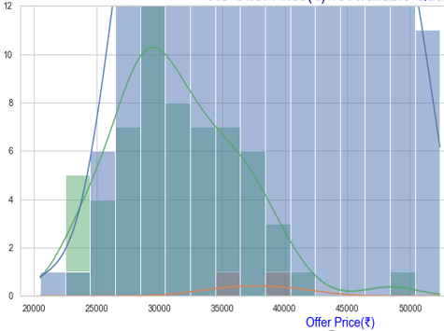
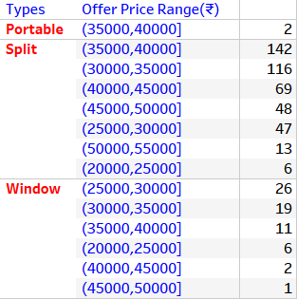
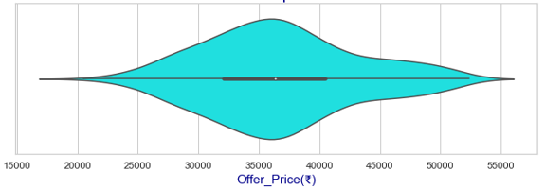
Most of Split ACs are available between ₹30,000- ₹40,000/-
Most of Window ACs are available between ₹25,000- ₹35,000/-
Portable ACs are available between ₹35,000- ₹40,000/-

Slide 13
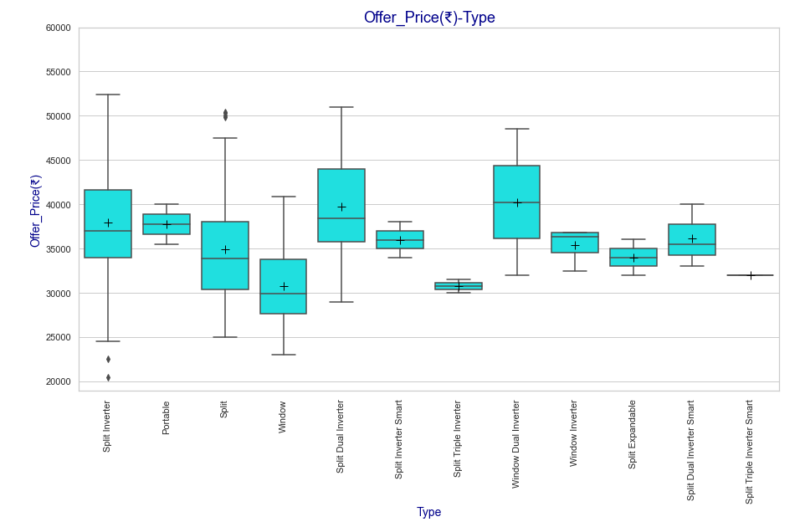
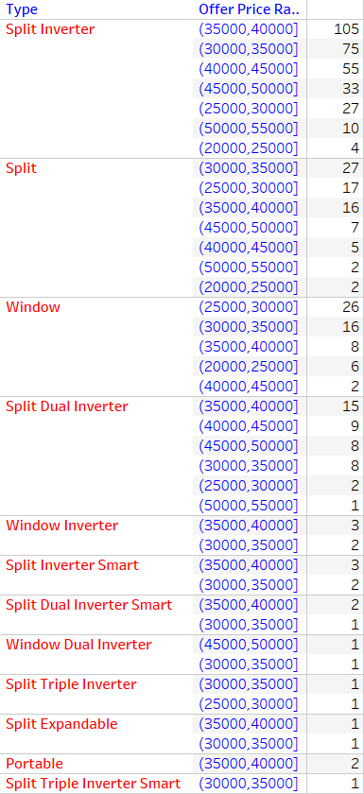

Slide 14
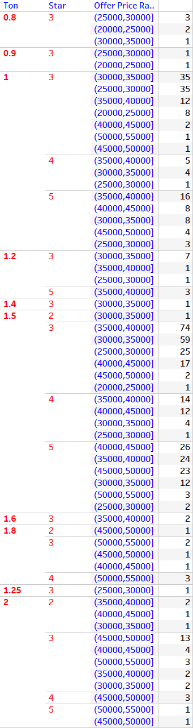
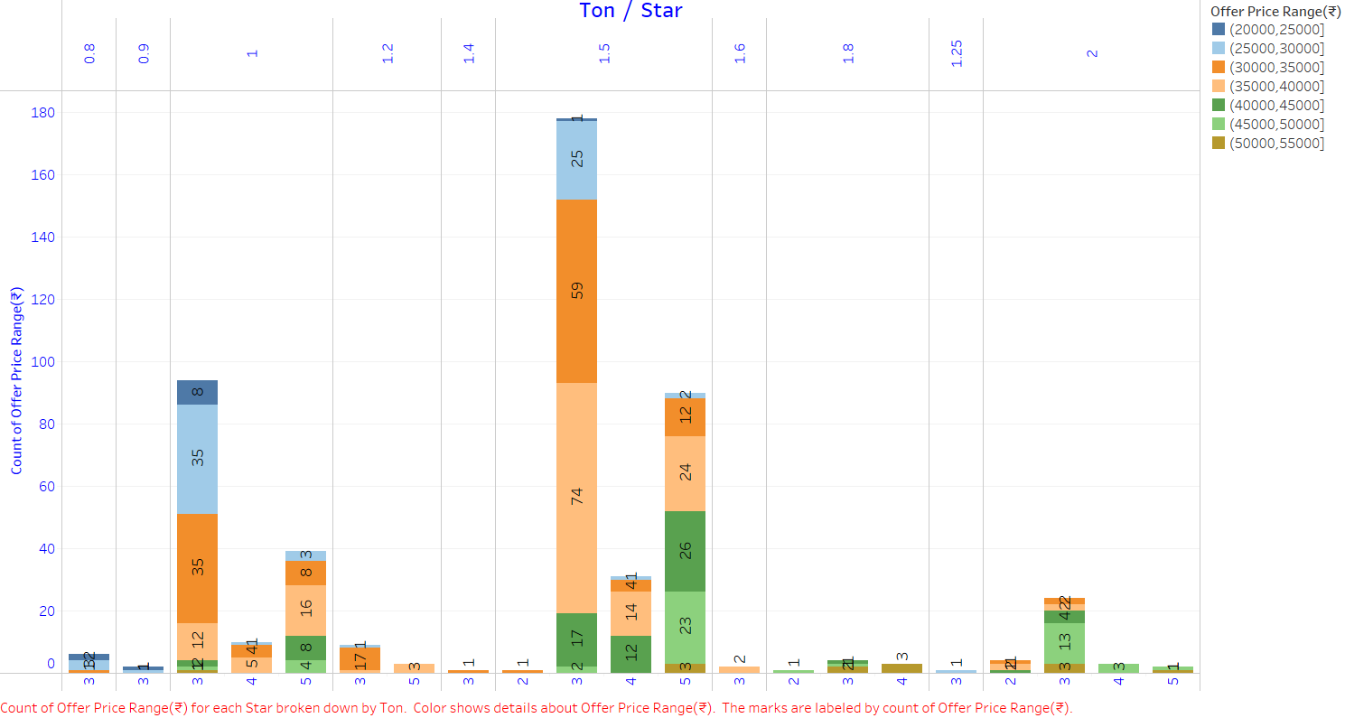
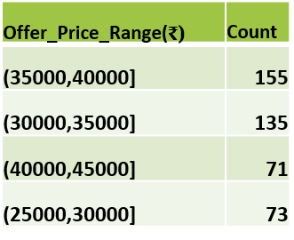
Most of the 1 Ton 3 Star ACs are available between ₹25,000- ₹35,000
Most of the 1 Ton 5 Star ACs are available between ₹35,000- ₹40,000
Most of the 1.5 Ton 3 Star ACs are available between ₹30,000- ₹40,000
Most of the 1.5 Ton 5 Star ACs are available between ₹35,000- ₹50,000

Slide 15
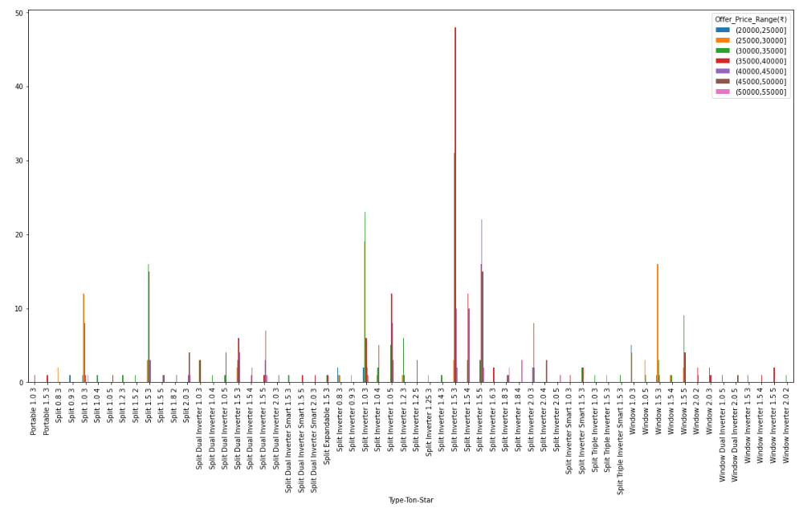

Slide 17
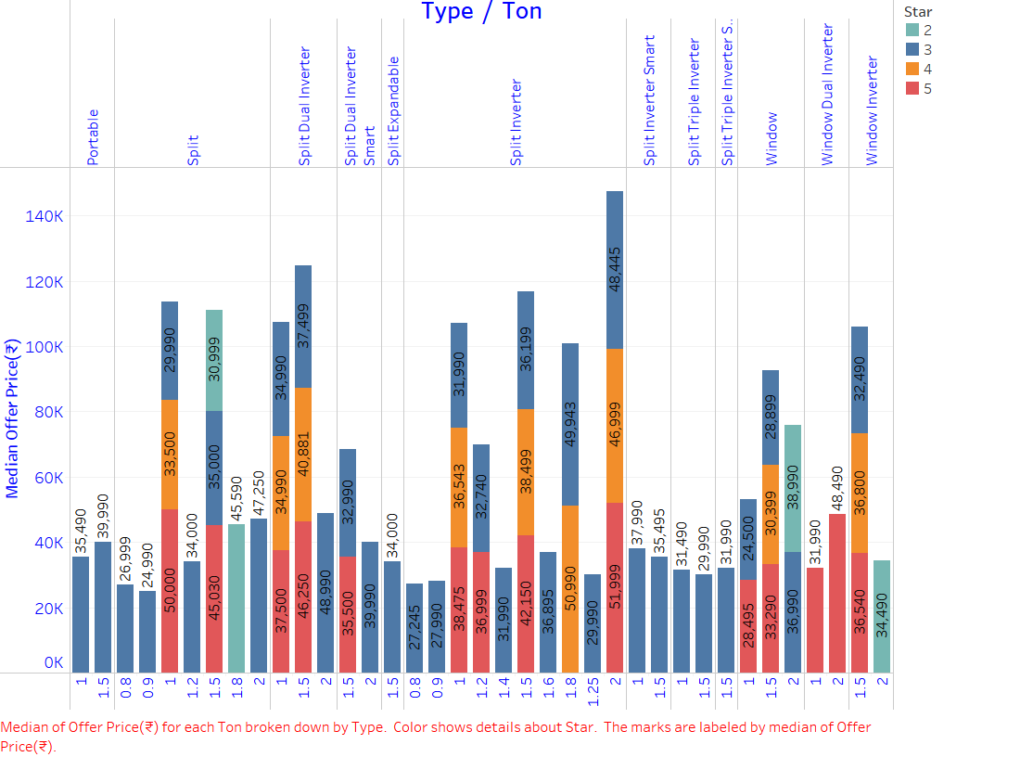
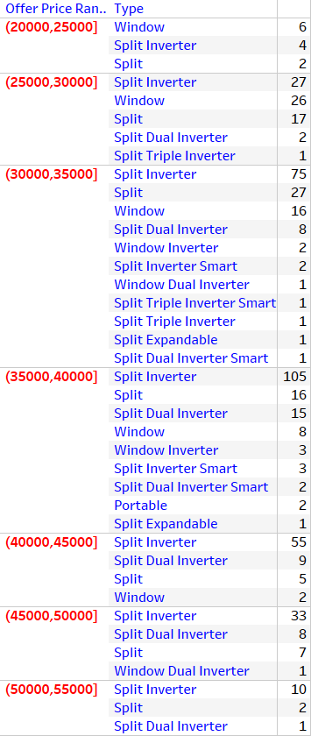
As cooling capacity & energy rating increasing Offer Price is increasing
Split ACs are costlier than Window ACs for the same Ton and Star rating
Split ACs with inverter technology are costlier than without it

Slide 19
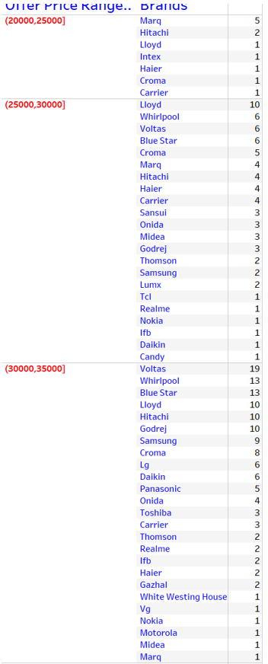
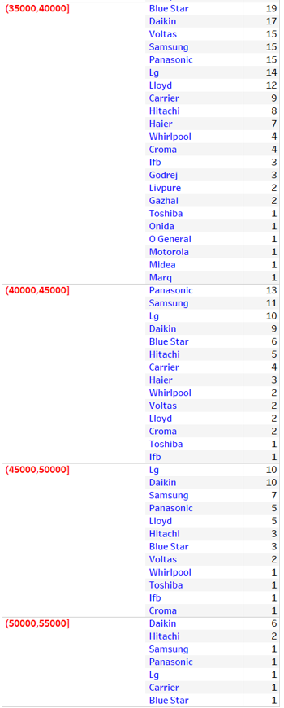

Slide 20
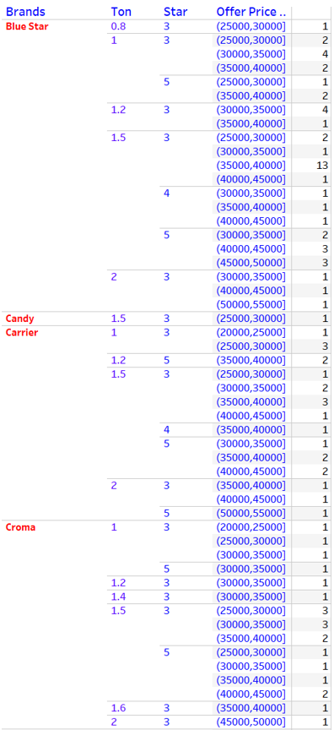
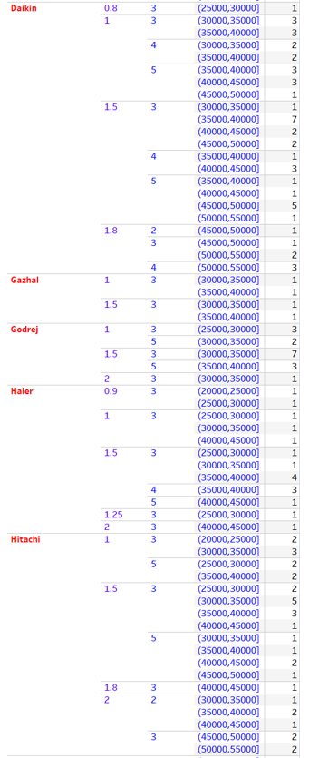
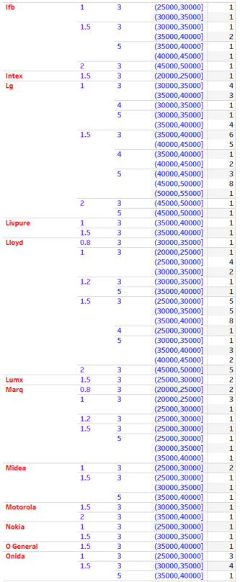
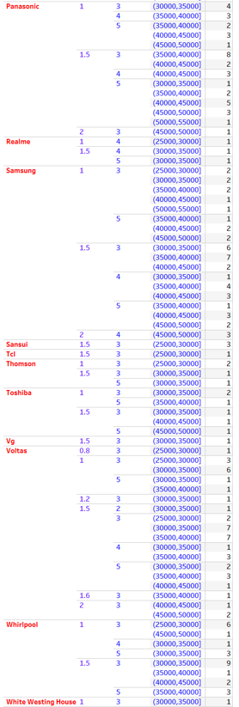

Slide 21
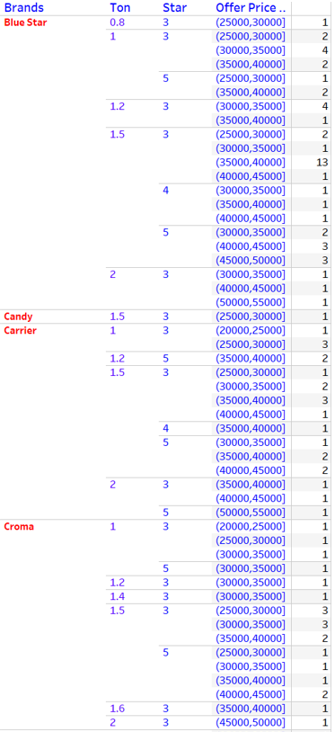
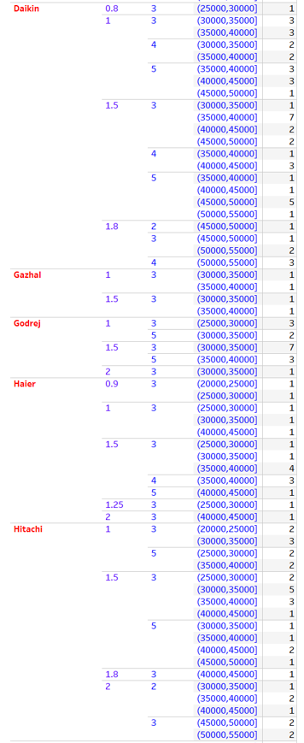
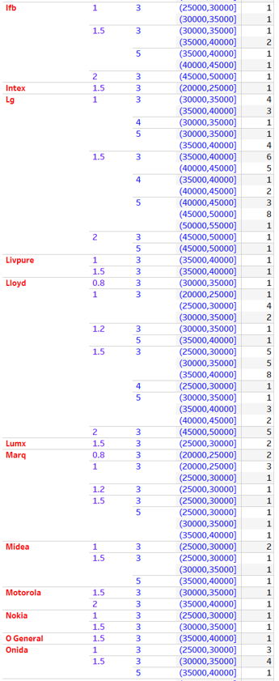
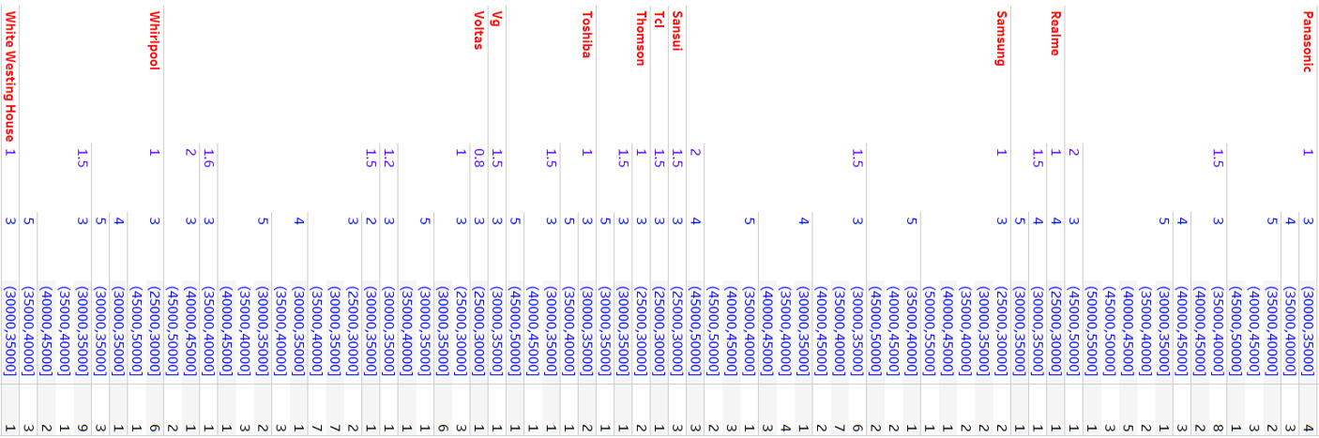

Slide 22
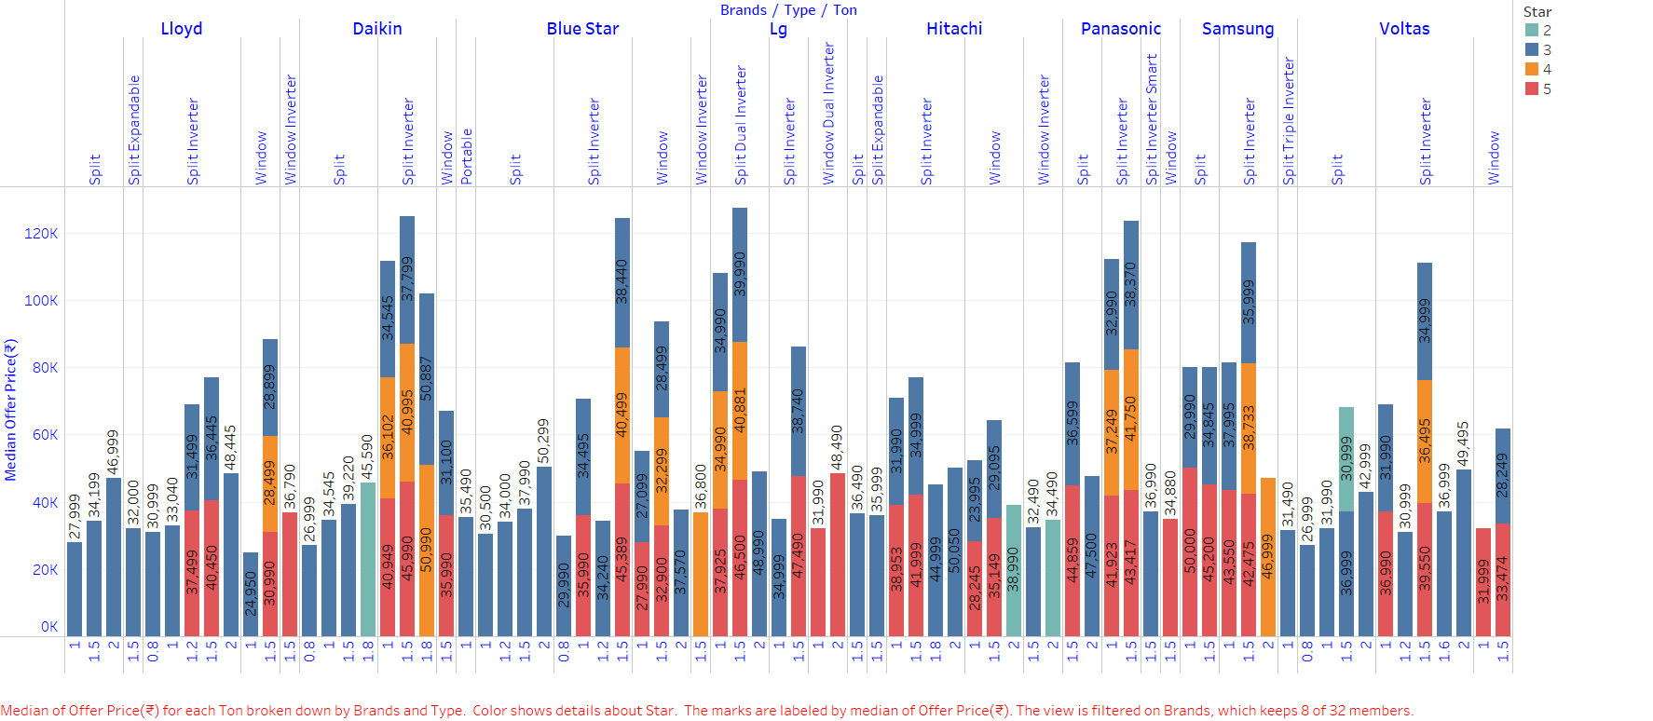
For 1 Ton 3 Star Rating -Marq Split Inverter AC is cheapest & for 1 Ton 4 Star Rating - Realme Split Inverter AC is cheapest
For 1 Ton 5 Star Rating- Hitachi Window AC is cheapest
For 1.5 Ton 3 Star Rating- Intex Window AC is cheapest & for 1.5 Ton 4 Star Rating- Lloyd Window AC is cheapest
For 1.5 Ton 5 Star Rating-Marq Window AC is cheapest
For 2 Ton 3 Star Rating- Godrej Window AC is cheapest & for 2 Ton 4 Star Rating-Samsung Split Inverter is cheapest
For 2 Ton 5 Star rating- LG Window Dual Inverter is Chepest.
Marq 0.8 Ton 3 Star Split Inverter AC is cheapest & Daikin 1.8 Ton 3 Star Split Inverter AC is costliest

Slide 26
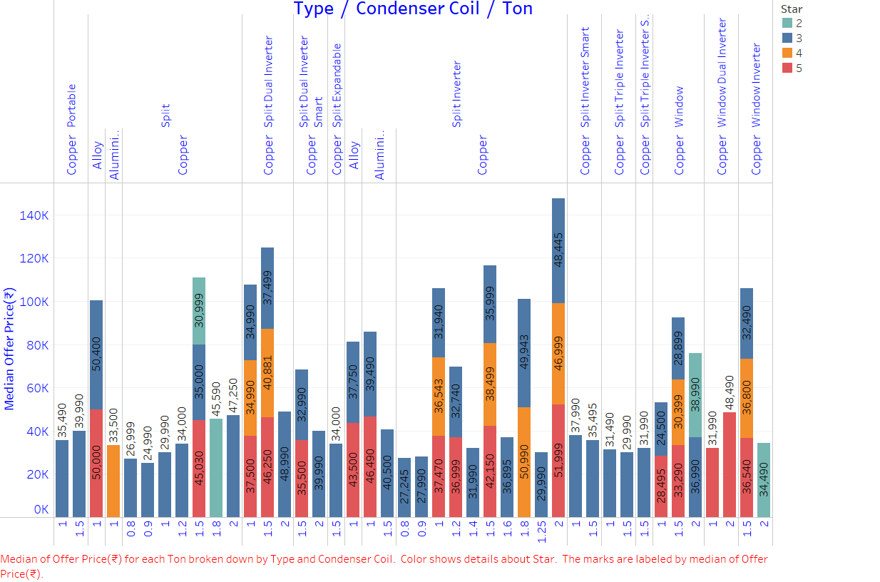
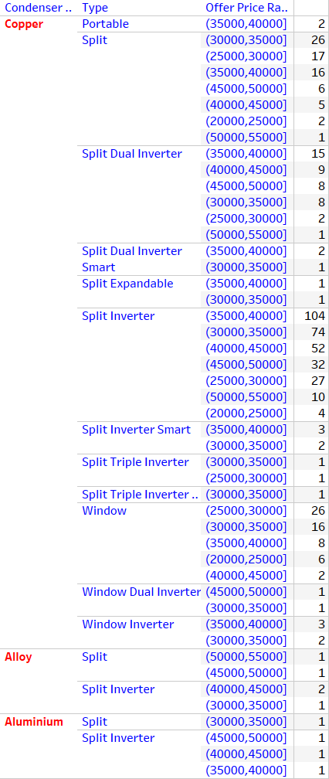
Split & Split Inverter ACs are available with all condenser types.
Al and alloy type condensers are suitable for 1 & 1.5 Tons.
Cu condensers are suitable for all cooling capacities & types.
For Split Inverter ACs Offer Price- Copper<Alloy<Aluminium
Split Inverter ACs with Cu condenser are abundantly available

Slide 27
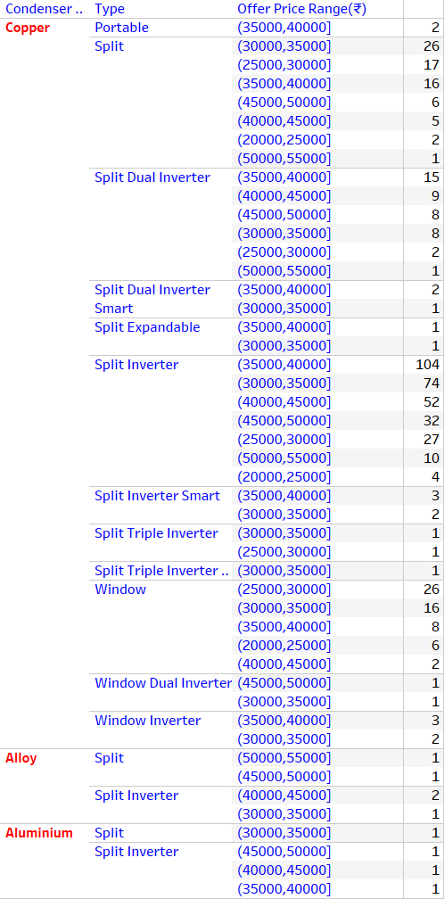

Slide 28
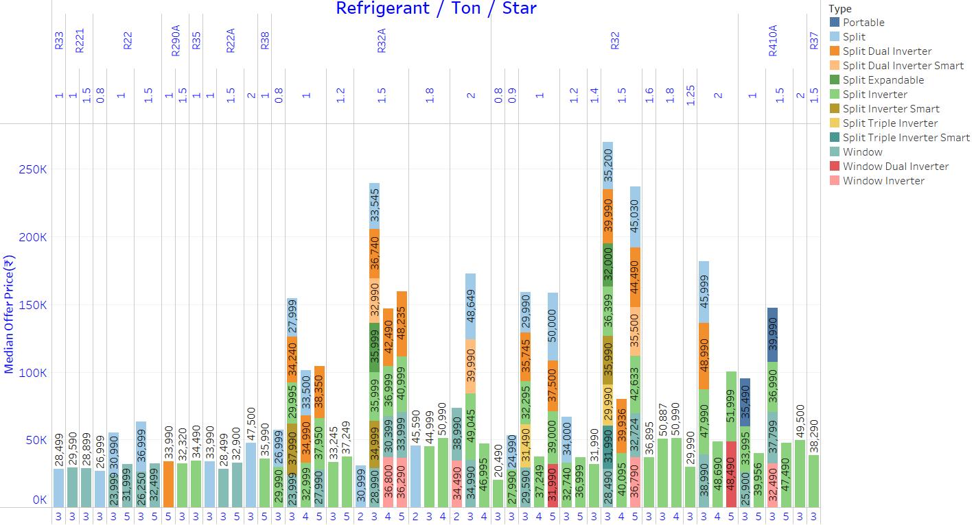
For Split AC 1 Ton 3 Star Min.Offer Price -R32<R32A<R33 <R22 <R22A
For Split Inverter AC 1 Ton 3 Star Min.Offer Price- R32<R32A<R410A<R35
For Split Inverter AC 1 Ton 5 Star Min.Offer Price-R32A<R32<R38<R410A
For Split AC 1 Ton 5 Star Min. Offer Price-R32
For Split AC 1 Ton 3 Star Min.Offer Price –R32<R32A<R33<R22<R22A
For Split AC 1.5 Ton 3 Star Min.Offer Price-R32<R32A<R22
For Split Inverter AC 1.5 Ton 3 Star Min. Offer Price-R32A<R32<R410A<R290A<R37
For Split Inverter AC 1.5 Ton 5 Star Min. Offer Price-R32A <R32<R410A
For Split Inverter AC 2 Ton 3 Star Min. Offer Price- R32< R410A<R32A
R221 is suitable for window ACs

Slide 31
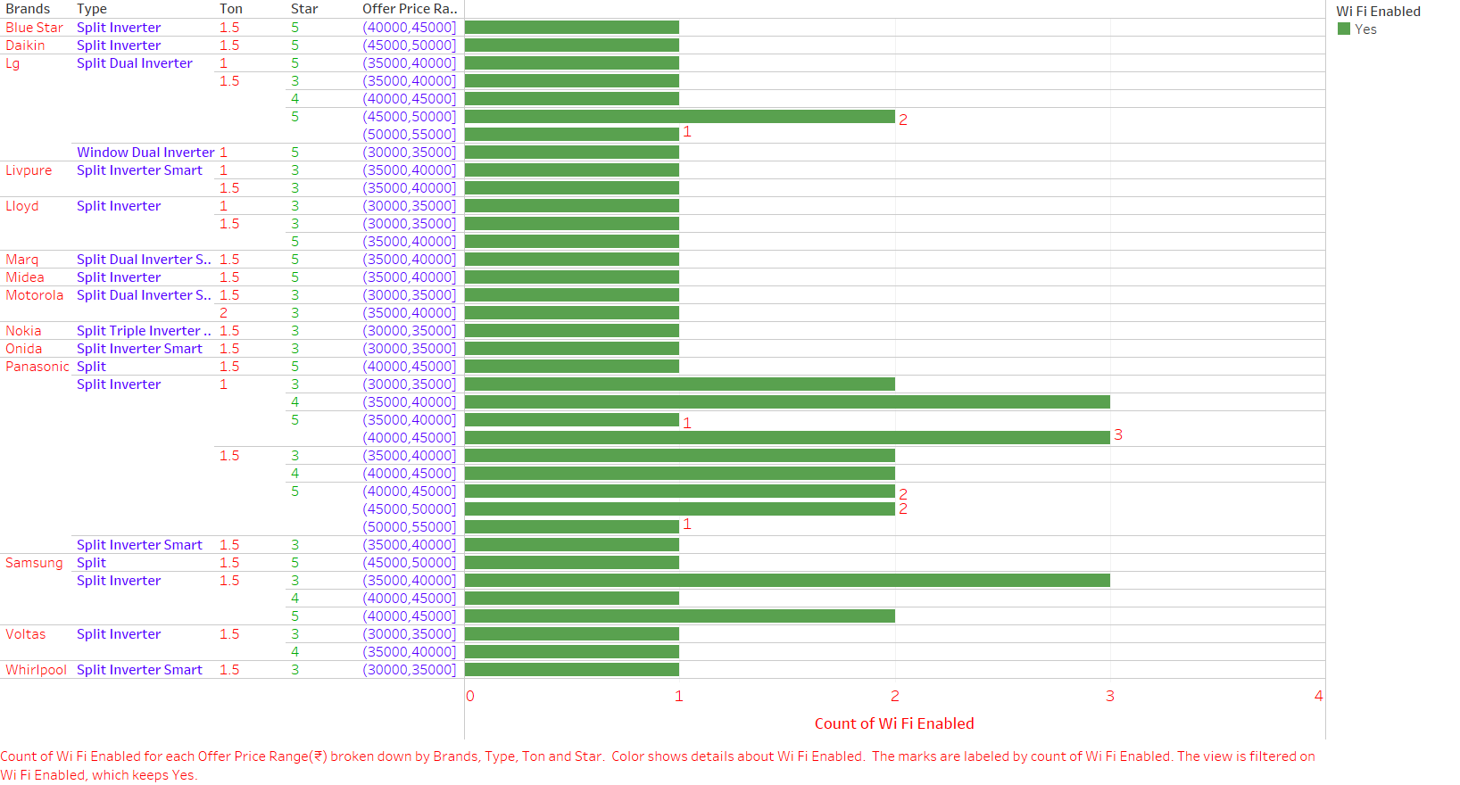
Voltas, Lg, Lloyd, Motorola, Nokia, Onida , Panasonic,Whirlpool- ₹30,000 - ₹35,000
Livpure, Samsung, Midea, Marq- ₹35,000 - ₹40,000
Blue Star- ₹40,000 - ₹45,000
Daikin-₹45,000 - ₹50,000

Slide 32
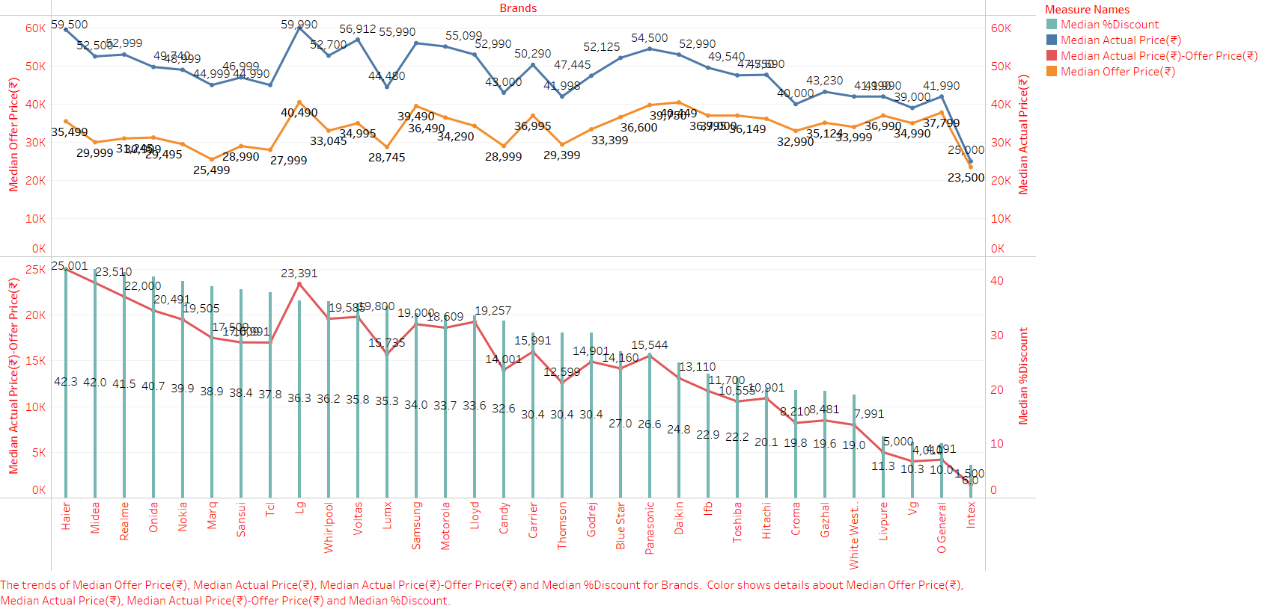

Slide 33
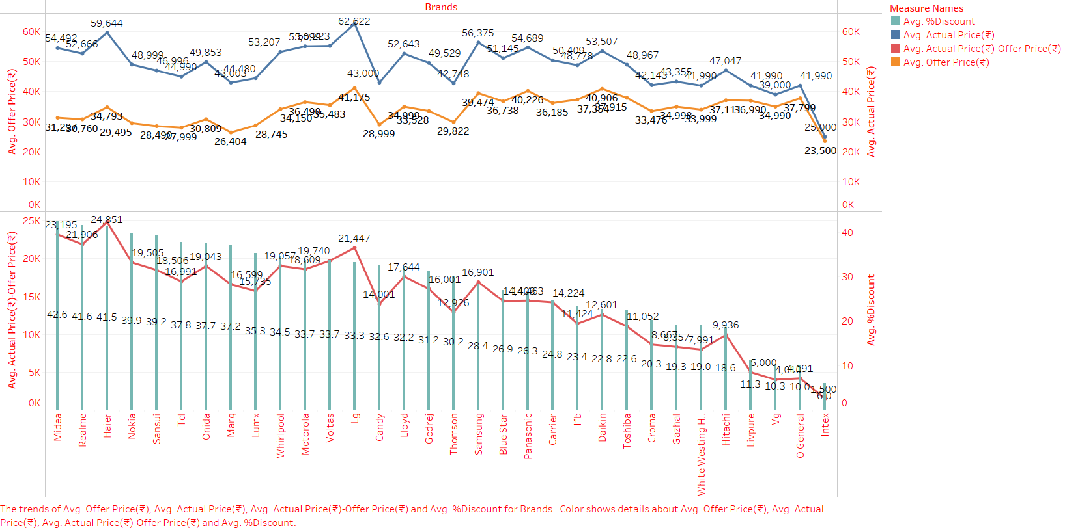
Midea, Realme & Haier are offering greater discounts
LG & Daikin ACs average offer prices are higher.
Intex & Marq ACs average offer prices are lower.

Slide 34
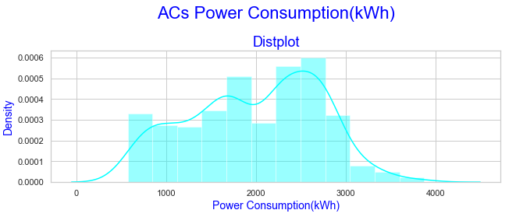
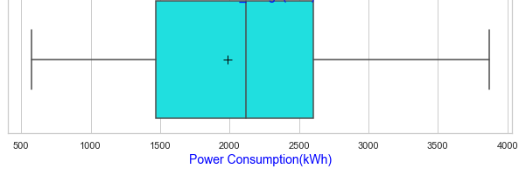
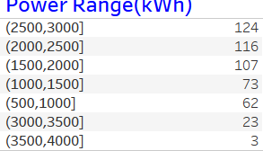
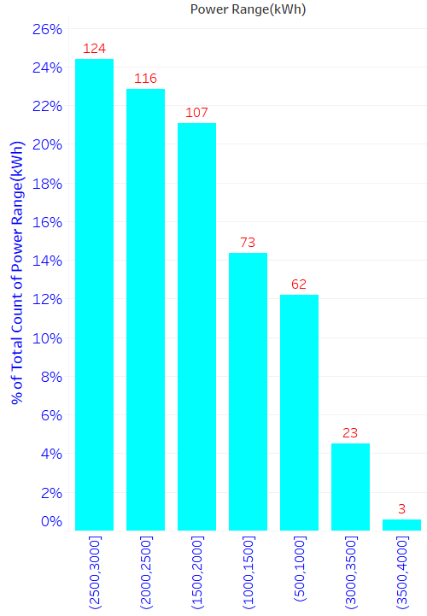
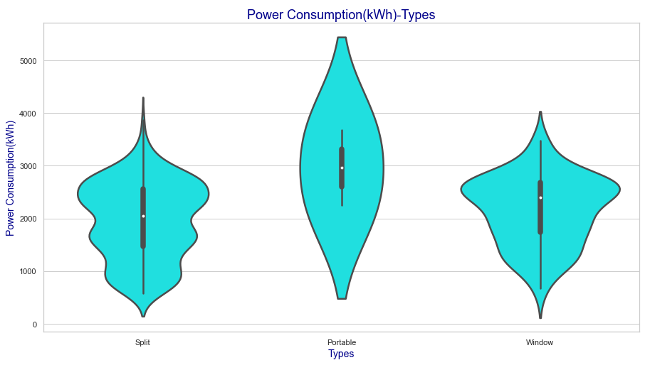

Slide 35



Slide 36


Most of the 1 Ton 3 Star ACs are consuming 1500-2000 kWh
Most of the 1 Ton 5 Star ACs are consuming 500-2000 kWh
Most of the 1.5 Ton 3 Star ACs are consuming 2500-3000 kWh
Most of the 1.5 Ton 5 Star ACs are consuming 2000-2500 kWh

Slide 37


Slide 39

LG & Lloyd ACs are energy efficient.
Power Consumption Range (kWh)-(2500-3000]>(2000-2500]>(1500-2000]

Slide 40





Slide 44


Split ACs are energy efficient than Window ACs
Split ACs with inverter technology are energy efficient than without it

Slide 46


Cu condensers are suitable for all power ranges & types.
For Split Inverter ACs Power Consumption:
1 Ton 5 Star Cu, Alloy, Al are approximately equal.
1 Ton 3 Star Alloy<Cu<Al

Slide 47
Power Consumption for
Type ,Ton ,Star & Condenser Coil

Slide 49

Split Dual Inverter 1 Ton 5 Star AC with R32 &R32A is consuming least power
For 1 Ton 3 Star Split AC Min.Power Consumption-R32A<R32<R33<R22<R22A
For 1 Ton 3 Star Split Inverter AC Min.Power Consumption-R32<R32A<R35=R410A
For 1 Ton 5 Star Split Inverter AC Min.Power Consumption-R32A<R32A<R410A<R38
R22 can be use for window and split copper condenser ACs with power consumption range between 1000-3000 kWh
R410A is suitable for all types and can be use for high energy consumption applications kWh<1500

Slide 52
Available Prices for
Type, Ton, Star & Power range

Slide 55
Available Powers & Prices for
Type, Ton, Star & Brands

Slide 59
Suggesting Minimum Offer Price AC for Type, Ton, Star, Power Range

Slide 62
Suggesting Minimum Offer Price AC for Type ,Ton ,Star ,Price range & Power range

Slide 66




Slide 67



Slide 68


ACs normal noise range is between 20dB to 65dB.
Split ACs are quieter than Window & Portable ACs.

Slide 69


Slide 70


Slide 71
Available Noise ranges & count
For Type, Ton & Star

Slide 73

LG and Daikin ACs are quieter
Blue Star ACs are noisier

Slide 74




Slide 75


Window ACs are noisier than Split ACs
Increase in tonnage increasing noise emission.

Slide 77
Brand & Min. offer Price for
Type ,Ton ,Star ,Price-Power-Noise Range
Noise range considered ['(20, 25]','(25, 30]','(30, 35]','(35, 40]']

Slide 81


For Split & Window ACs of 1T & 1.5T Voltas is preferable
For Split inverter of 1T & 1.5T Daikin or Samsung is preferable
For Split Dual Inverter of 1T & 1.5T LG is preferable

Slide 82
Brand & Min. offer Price for
Type ,Ton ,Star ,Price-Power-Review Range
Review Avg Star-(3.5,4.0],(4.0,4.5],(4.5,5.0]

Slide 86


Slide 87




CONCLUSION

Slide 88

THANK YOU

